Slide 1
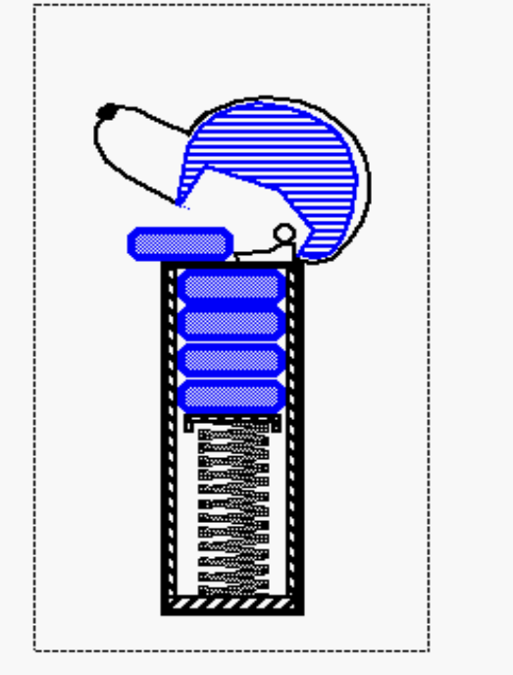
Stacks
Abstract Data Types (ADTs)
Stacks
Interfaces and exceptions
Java implementation of a stack
Application to the analysis of a time series
Growable stacks
Stacks in the Java virtual machine

Slide 2
Abstract Data Types (ADTs)
ADT is a mathematically specified entity that defines a set of its instances, with:
  a specific interface – a collection of signatures of operations that can be invoked on an instance,
  a set of axioms (preconditions and postconditions) that define the semantics of the operations (i.e., what the operations do to instances of the ADT, but not how)

Slide 3
Abstract Data Types (ADTs)
  Types of operations:
    Constructors
    Access functions
    Manipulation procedures

Slide 4
Abstract Data Types
Why do we need to talk about ADTs in a DS course?
  They serve as specifications of requirements for the building blocks of solutions to algorithmic problems
  Provides a language to talk on a higher level of abstraction
  ADTs encapsulate data structures and algorithms that implement them
  Separate the issues of correctness and efficiency

Slide 5
Example - Dynamic Sets
We will deal with ADTs, instances of which are sets of some type of elements.
  Operations are provided that change the set
We call such class of ADTs dynamic sets

Slide 6
Dynamic Sets (2)
An example dynamic set ADT
  Methods:
    New():ADT
    Insert(S:ADT, v:element):ADT
    Delete(S:ADT, v:element):ADT
    IsIn(S:ADT, v:element):boolean
  Insert and Delete – manipulation operations
  IsIn – Access method method

Slide 7
Dynamic Sets (3)
Axioms that define the methods:
  IsIn(New(), v) = false
  IsIn(Insert(S, v), v) = true
  IsIn(Insert(S, u), v) = IsIn(S, v), if v ≠ u
  IsIn(Delete(S, v), v) = false
  IsIn(Delete(S, u), v) = IsIn(S, v), if v ≠ u

Slide 8
Other Examples
Simple ADTs:
  Queue
  Deque
  Stack

Slide 9
Stacks
A stack is a container of objects that are inserted and removed according to the last-in-first-out (LIFO) principle.
Objects can be inserted at any time, but only the last (the most-recently inserted) object can be removed.
Inserting an item is known as “pushing” onto the stack. “Popping” off the stack is synonymous with removing an item.

Slide 10
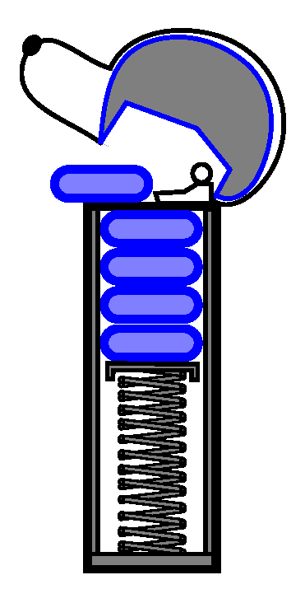
Stacks (2)
A PEZ ® dispenser as an analogy:

Slide 11
Stacks(3)
A stack is an ADT that supports four main methods:
  new():ADT – Creates a new stack
  push(S:ADT, o:element):ADT - Inserts object o onto top of stack S
  pop(S:ADT):ADT - Removes the top object of stack S; if the stack is empty an error occurs
  top(S:ADT):element – Returns the top object of the stack, without removing it; if the stack is empty an error occurs

Slide 12
Stacks(4)
The following support methods could also be defined:
  size(S:ADT):integer - Returns the number of objects in stack S
  isEmpty(S:ADT): boolean - Indicates if stack S is empty
Axioms
  Pop(Push(S, v)) = S
  Top(Push(S, v)) = v

Slide 13
Java Stuff
Given the stack ADT, we need to code the ADT in order to use it in the programs. We need two constructs: interfaces and exceptions.
An interface is a way to declare what a class is to do. It does not mention how to do it.
  For an interface, we just write down the method names and the parameters. When specifying parameters, what really matters is their types.
  Later, when we write a class for that interface, we actually code the content of the methods.
  Separating interface and implementation is a useful programming technique.

Slide 14
A Stack Interface in Java
The stack data structure is a “built-in” class of Java’s java.util package. But we define our own stack interface:
public interface Stack {
// accessor methods
public int size();
public boolean isEmpty();
public Object top() throws StackEmptyException;
// update methods
public void push (Object element);
public Object pop() throws StackEmptyException;
}

Slide 15
Exceptions
Exceptions are yet another programming construct, useful for handling errors. When we find an error (or an exceptional case), we just throw an exception.
As soon as the exception is thrown, the flow of control exits from the current method and goes to where that method was called from.
What is the point of using exceptions? We can delegate upwards the responsibility of handling an error. Delegating upwards means letting the code who called the current code deal with the problem.

Slide 16
More Exceptions
public void eatPizza() throws StomachAcheException
{...
if (ateTooMuch)
throw new StomachAcheException(“Ouch”);
...}
So when
StomachAcheException
is thrown, we exit from
method eatPizza() and
go to TA.eatpizza().
private void simulateMeeting()
{...
try
{TA.eatPizza();}
catch (StomachAcheException e)
{system.out.println(“somebody has a stomach ache”);}
...}

Slide 17
Even More Exceptions
The try block and the catch block means that we are listening for exceptions that are specified in the catch parameter.
Because catch is listening for StomachAcheException, the flow of control will now go to the catch block. And System.out.println will get executed.
Note that a catch block can contain anything. It does not have to do only System.out.println. We can handle the caught error in any way you like; we can even throw them again.

Slide 18
Exceptions (finally)
Note that if somewhere in your method, you throw an exception, you need to add a throws clause next to your method name.
If you never catch an exception, it will propagate upwards and upwards along the chain of method calls until the user sees it.
What exactly are exceptions in Java? Classes.
public class StomachAcheException extends RuntimeException {
public StomachAcheException (String err)
{super(err);}
}

Slide 19

Array-Based Stack in Java
Create a stack using an array by specifying a maximum size N for our stack.
The stack consists of an N-element array S and an integer variable t, the index of the top element in array S.
Array indices start at 0, so we initialize t to -1

Slide 20
Array-Based Stack in Java (2)
public class ArrayStack implements Stack {
// Implementation of the Stack interface using an array
public static final int CAPACITY = 1024;
// default capacity of stack
private int N; // maximum capacity of the stack
private Object S[ ]; // S holds the elements of the stack
private int t = -1; // the top element of the stack
public ArrayStack( ) // Initialize the stack with default capacity
{ this(CAPACITY) }
public ArrayStack(int cap)
// Initialize the stack with given capacity
{N = cap; S = new Object[N]}

Slide 21
Array-Based Stack in Java (3)
public int size( ) //Return the current stack size
{return (t + 1)}
public boolean isEmpty( ) //Return true iff the stack is empty
{return (t < 0)}
public void push(Object obj) throws StackFullException{
//Push a new element on the stack
if (size() == N)
throw new StackFullException(“Stack overflow.”)
S[++t] = obj;}

Slide 22
Array-Based Stack in Java (4)
public Object top( ) throws StackEmptyException {
// Return the top stack element
if (isEmpty( ))
throw new StackEmptyException(“Stack is empty.”);
return S[t]}
public Object pop() throws StackEmptyException {
// Pop off the stack element
Object elem;
if (isEmpty( ))
throw new StackEmptyException(“Stack is Empty.”);
elem = S[t];
S[t--] = null; // Dereference S[top] and decrement top
return elem}}

Slide 23
Array-Based Stack in Java (5)
The array implementation is simple and efficient (methods performed in O(1)).
There is an upper bound, N, on the size of the stack. The arbitrary value N may be too small for a given application, or a waste of memory.
StackEmptyException is required by the interface.
StackFullException is particular to this implementation.

Slide 24
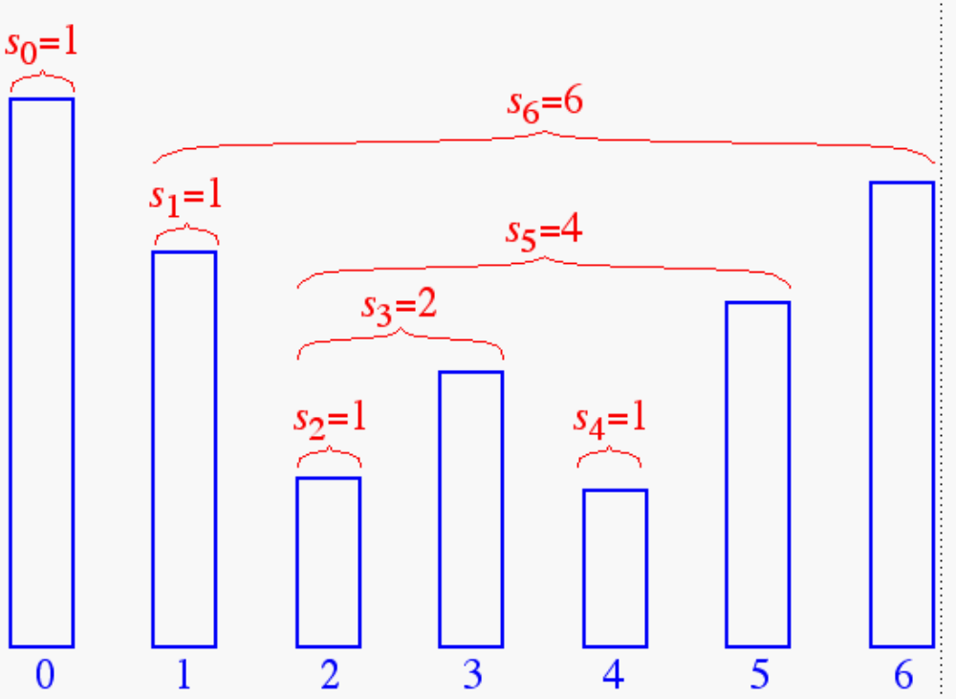
Application: Time Series
The span s_{i} of a stock’s price on a certain day i is the maximum number of consecutive days (up to the current day) the price of the stock has been less than or equal to its price on day i

Slide 25
An Inefficient Algorithm
Algorithm computeSpans1(P):
Input: an n-element array P of numbers such that P[i] is the price of the stock on day i
Output: an n-element array S of numbers such that S[i] is the span of the stock on day i
for i ← 0 to n - 1 do
k ← 0; done ← false
repeat
if P[i - k] ≤ P[i] then k ← k + 1
else done ← true
until (k = i) or done
S[i] ← k
return S
The running time of this algorithm is O(n²). Why?

Slide 26
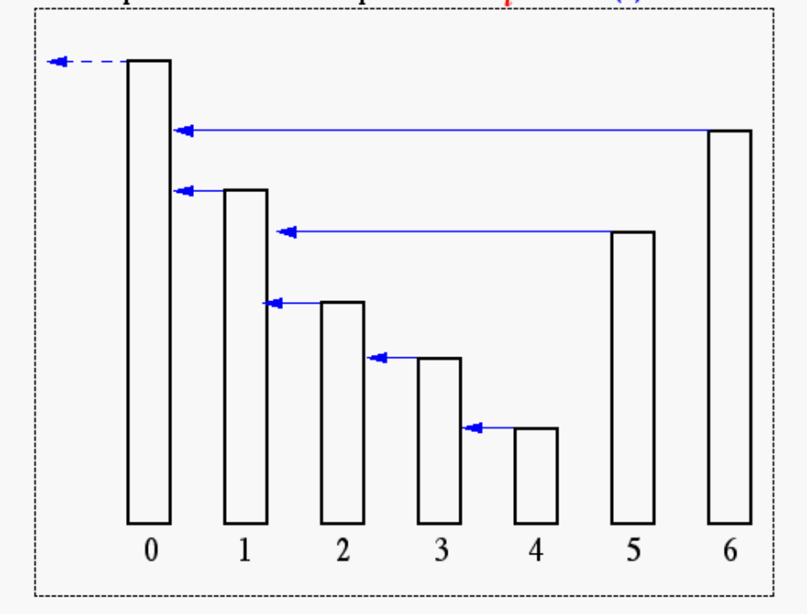
A Stack Can Help
s_{i} can be easily computed if we know the closest day preceding i, on which the price is greater than the price on day i. If such a day exists, let’s call it h(i), otherwise, we conventionally define h(i) = -1
In the figure, h(3)=2, h(5)=1 and h(6)=0.
The span is now computed as s_{i} = i - h(i)

Slide 27
What to do with the Stack?
What are possible values of h(7)?
Can it be 1 or 3 or 4?
No, h(7) can only be 2 or 5 or 6.
1
2
3
4
5
6
We store indices 2,5,6 in the stack.
To determine h(7) we compare the price on day 7 with prices on day 6, day 5, day 2 in that order.
The first price larger than the price on day 7 gives h(7)
The stack should be updated to reflect the price of day 7
It should now contains 2,5,7

Slide 28
An Efficient Algorithm
Algorithm computeSpans2(P):
Let D be an empty stack
for i ←0 to n - 1 do
k ← 0; done ← false
while not (D.isEmpty() or done) do
if P[i] ≥ P[D.top()] then D.pop()
else done ← true
if D.isEmpty() then h ← -1
else h ← D.top()
S[i] ← i - h
D.push(i)
return S

Slide 29
A Growable Array-Based Stack
Instead of giving up with a StackFullException, we can replace the array S with a larger one and continue processing push operations.
    Algorithm push(o)
    if size() = N then A ← new array of length f(N)
    for i ← 0 to N – 1
    A[i] ← S[i]
    S ← A; t ← t + 1
    S[t] ← o
How large should the new array be?
  tight strategy (add a constant): f(N) = N + c
  growth strategy (double up): f(N) = 2N

Slide 30
Tight vs. Growth Strategies: a comparison
To compare the two strategies, we use the following cost model:
A regular push operation: adds one element and cost one unit.
A special push operation: create an array of size f(N), copy N elements, and add one element. Costs f(N)+N+1 units

Slide 31
Tight Strategy (c=4)
start with an array of size 0. cost of a special push is 2N + 5
a
4+1
1
1
1
a
b
Phase 1
a
b
c
a
b
c
d
a
b
c
d
e
8+4+1
1
1
1
a
b
c
d
e
f
Phase 2
a
b
c
d
e
f
g
a
b
c
d
e
f
g
h
a
b
c
d
e
f
g
h
i
12+8+1
1
1
1
a
b
c
d
e
f
g
h
i
k
Phase 3
a
b
c
d
e
f
g
h
i
k
l
a
b
c
d
e
f
g
h
i
k
l
m
a
b
c
d
e
f
g
h
i
k
l
m
n
16+12+1

Slide 32
Performance of the Tight Strategy
In phase i the array has size c£i
Total cost of phase i is
  c£i is the cost of creating the array
  c£(i-1) is the cost of copying elements into new array
  c is the cost of the c pushes.
Hence, cost of phase i is 2ci
In each phase we do c pushes. Hence for n pushes we need n/c phases. Total cost of these n/c phases is
= 2c (1 + 2 + 3 + ... + n/c) t O(n²/c)

Slide 33
Growth Strategy
start with an array of size 0. cost of a special push is 3N + 1
a
1+0+1
2+1+1
4+2+1
1
Phase 0
a
b
Phase 1
a
b
c
Phase 2
a
b
c
d
a
b
c
d
e
8+4+1
1
1
1
a
b
c
d
e
f
Phase 3
a
b
c
d
e
f
g
a
b
c
d
e
f
g
h
a
b
c
d
e
f
g
h
i
16+8+1
a
b
c
d
e
f
g
h
i
k
1
a
b
c
d
e
f
g
h
i
k
l
1
Phase 4
a
b
c
d
e
f
g
h
i
k
l
m
1
a
b
c
d
e
f
g
h
i
k
l
m
n
1

Slide 34
Performance of the Growth Strategy
In phase i the array has size 2^{i}
Total cost of phase i is
  2^{i} is the cost of creating the array
  2^{i-1} is the cost of copying elements into new array
  2^{i-1} is the cost of the 2^{i-1} pushes done in this phase
Hence, cost of phase i is 2^{i+1}.
If we do n pushes, we will have log n phases.
Total cost of n pushes
= 2 + 4 + 8 + ... + 2^{log n+1} = 4n – 1
The growth strategy wins!

Slide 35
Stacks in the Java Virtual Machine
Each process running in a Java program has its own Java Method Stack.
Each time a method is called, it is pushed onto the stack.
The choice of a stack for this operation allows Java to do several useful things:
  Perform recursive method calls
  Print stack traces to locate an error

Slide 36
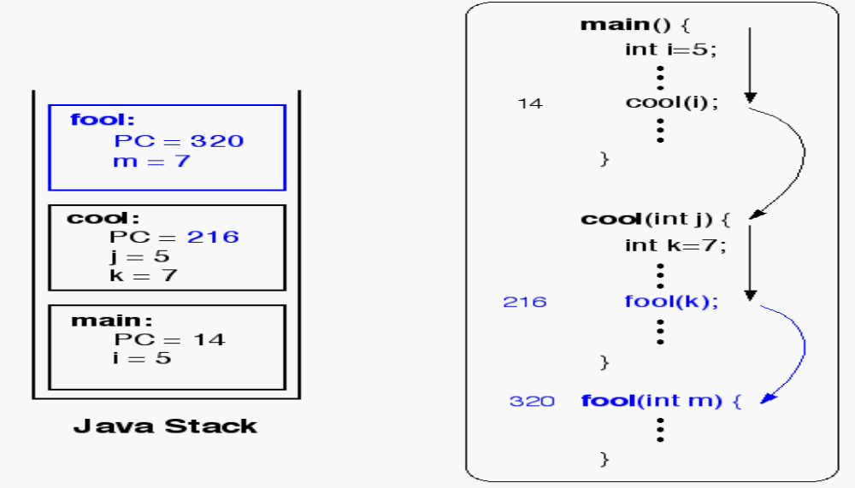
Java Method Stack

